Slide 1


Slide 2
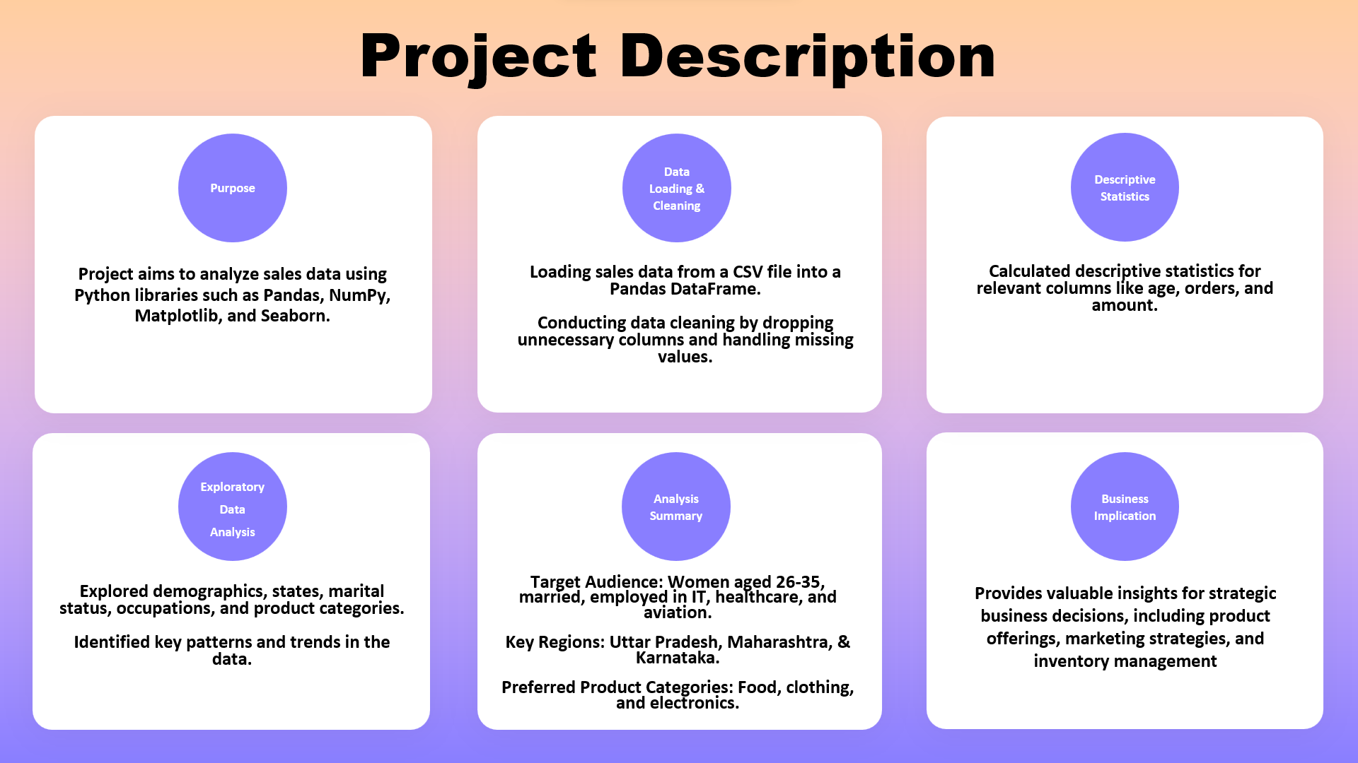

Slide 3
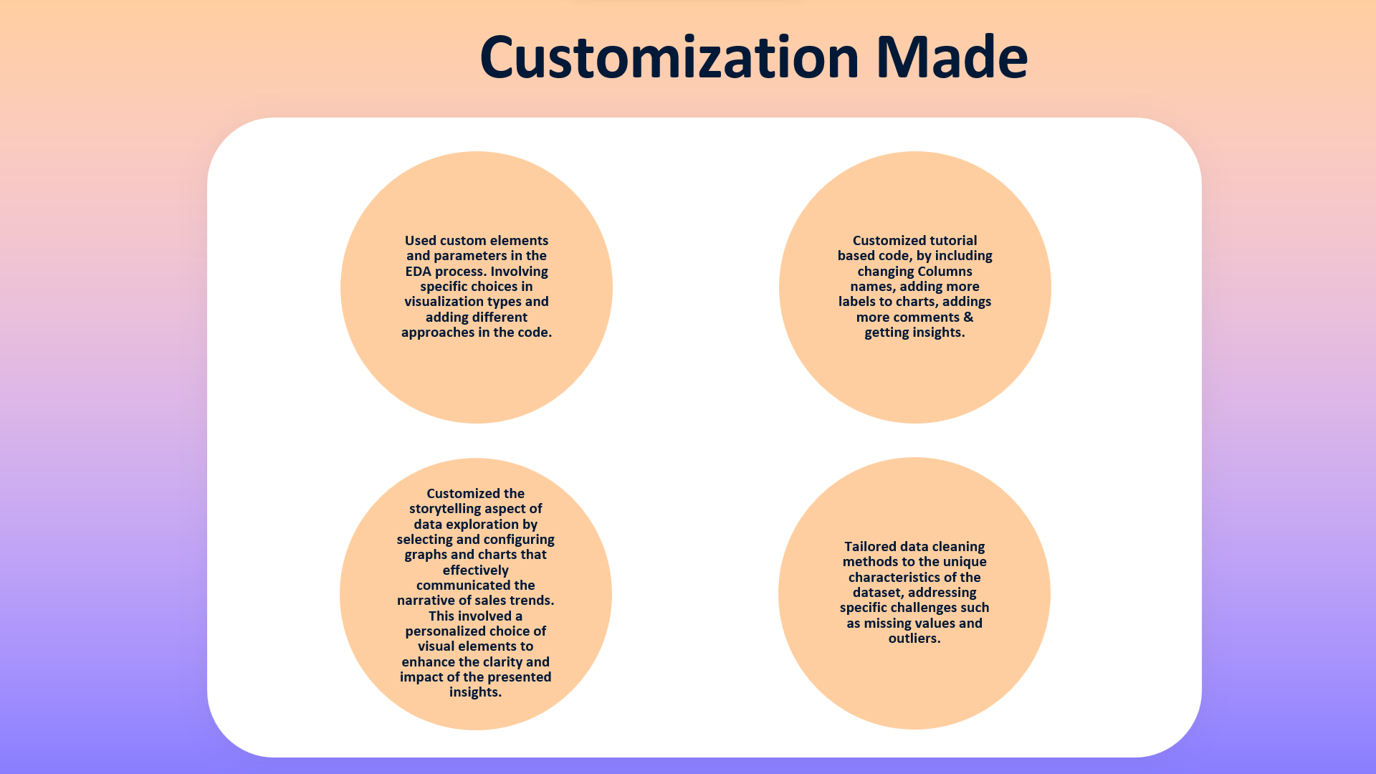

Slide 4
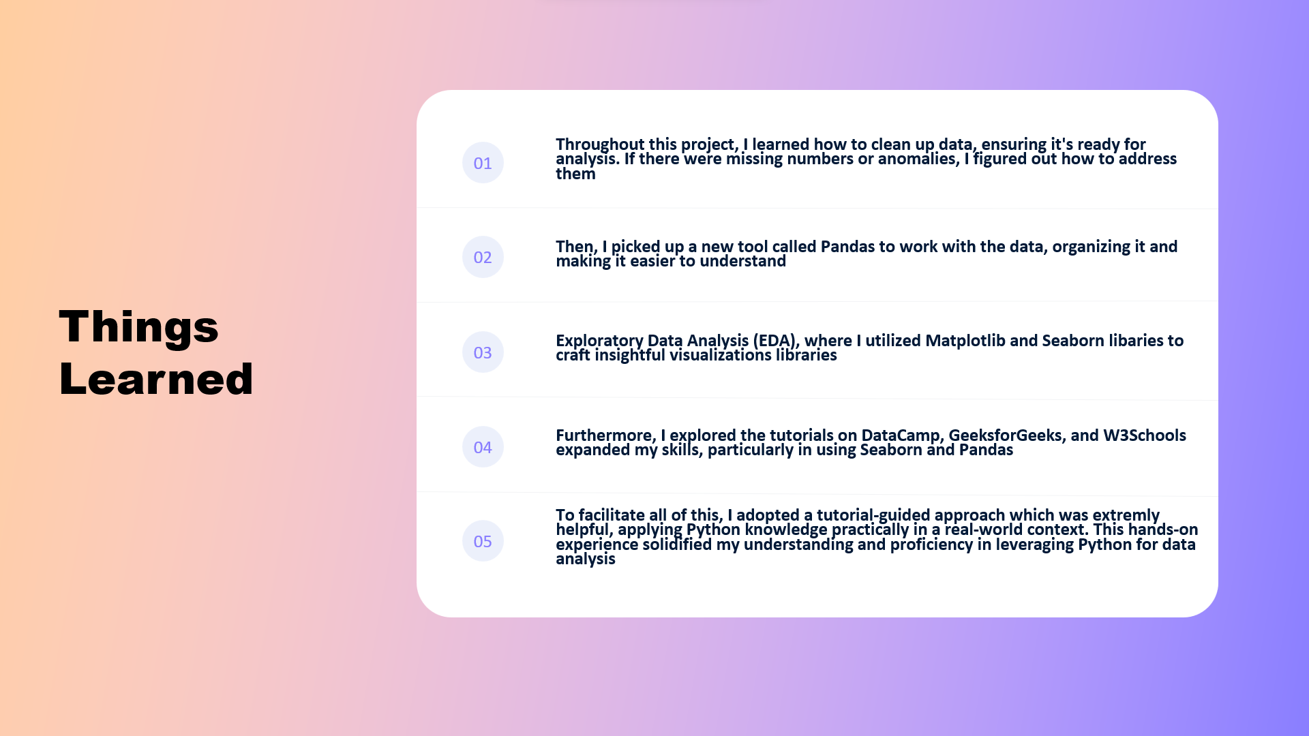

Slide 5
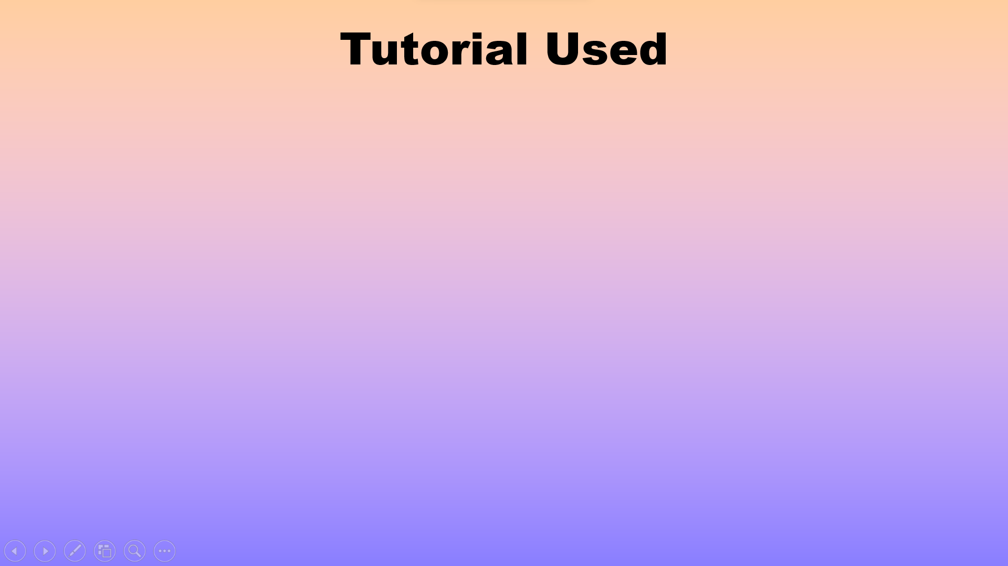







Slide 6

Video Tutorial
Please click on the button to view the project demonstration

Slide 7


